Slide 1
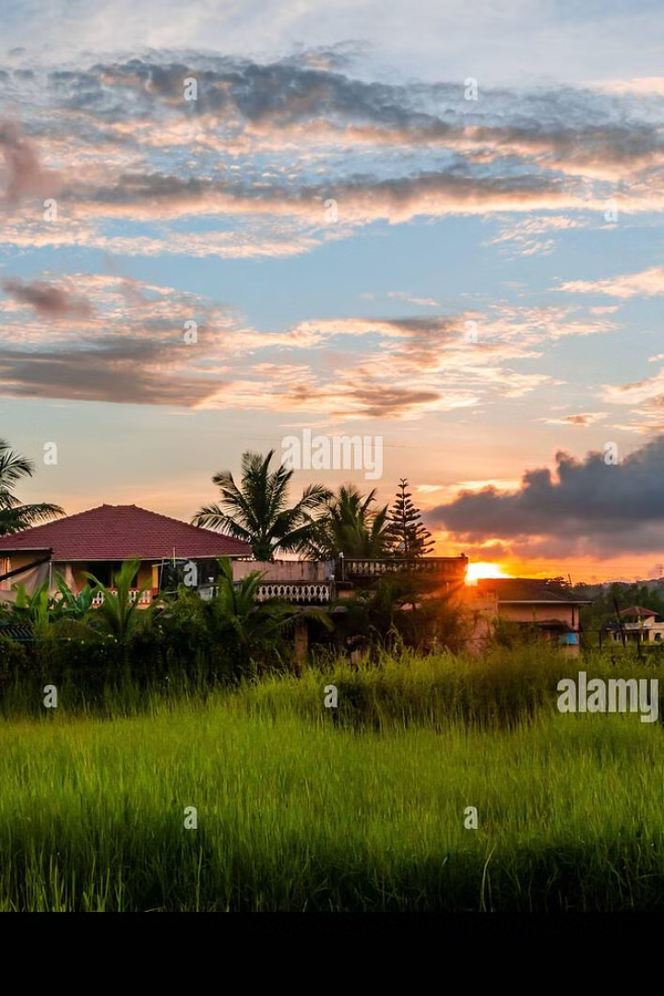
KNECT: Bridging Gaps in India 🌍📚⚕️⚖️
KNECT is a unique NGO dedicated to empowering rural communities by providing access to education, healthcare, and legal aid. We strive to create a more inclusive society by ensuring that underserved populations receive the support they need for a brighter future. KNECT envisions a world where every individual, regardless of their location or socioeconomic status, has the opportunity to thrive. Join us in our mission to empower rural India through education, healthcare, and justice.

Slide 2
The Challenge: Disparities in Rural India
Education
Healthcare
Justice
The literacy rate in rural India lags urban areas by 15%, according to the National Statistical Office (2023). This disparity highlights the urgent need for improved educational opportunities in rural communities.
Only 36% of rural Indians have access to adequate healthcare facilities (WHO, 2022). This lack of access results in preventable diseases and higher mortality rates.
Over 70% of the rural population is unaware of their legal rights (Ministry of Law and Justice, 2024). This lack of awareness makes them vulnerable to exploitation and injustice.

Slide 3
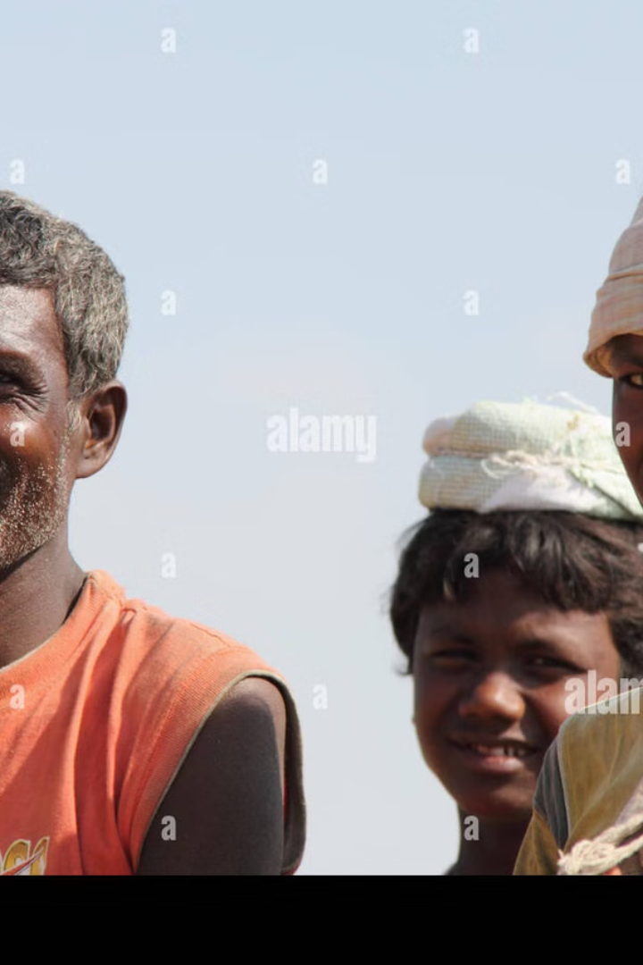
KNECT's Mission and Vision
1
Mission
2
Vision
To empower underserved rural communities in India by providing access to quality education, healthcare, and legal aid. We aim to break down the barriers that prevent individuals from reaching their full potential.
A more inclusive and equitable society where every individual has the opportunity to thrive, regardless of their location or socioeconomic status. We envision a future where rural communities are empowered and self-sufficient.
3
Values
Integrity, compassion, and commitment to social justice. We operate with the highest ethical standards and prioritize the needs of the communities we serve. We strive for long-term sustainability and impact.

Slide 4
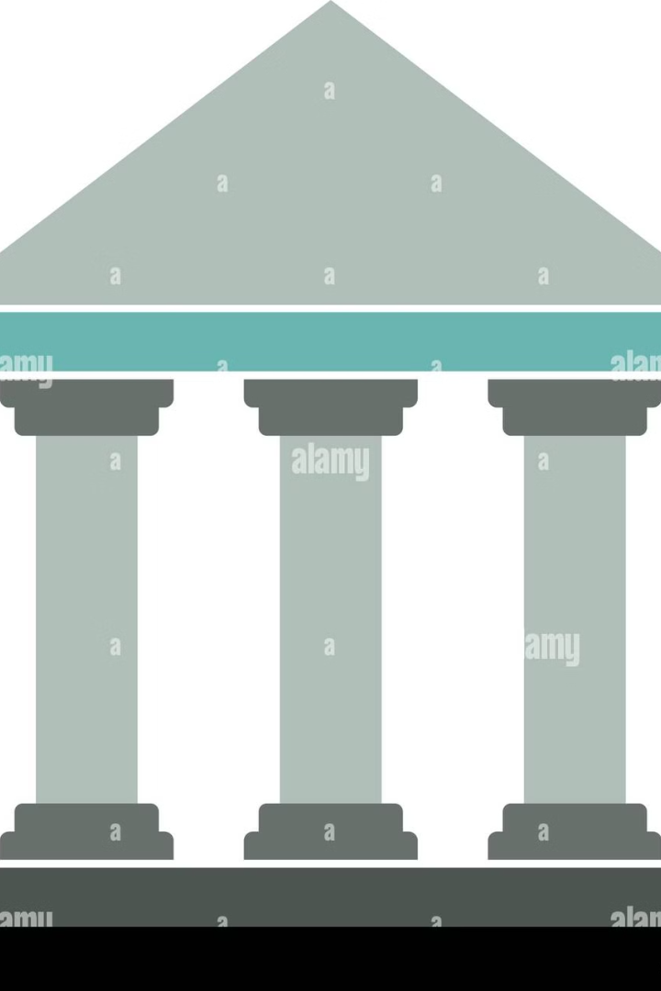



KNECT's Three Pillars of Empowerment
Education Programs
Healthcare Initiatives
Legal Aid Services
Establishing and supporting schools in remote areas. Providing scholarships and educational resources to underprivileged students (Targeting 500 scholarships in 2025). Implementing vocational training programs for sustainable livelihoods (Goal: 75% placement rate).
Organizing medical camps and health awareness campaigns (Reached over 10,000 individuals in 2023). Providing access to essential medicines and healthcare services (Partnering with 10 local pharmacies). Training local health workers to address community needs (Trained 50 community health workers in 2024).
Conducting legal awareness workshops and clinics (Held 25 workshops in 2023). Providing pro bono legal assistance to marginalized communities (Assisted over 300 cases). Advocating for policy changes to promote social justice.

Slide 5
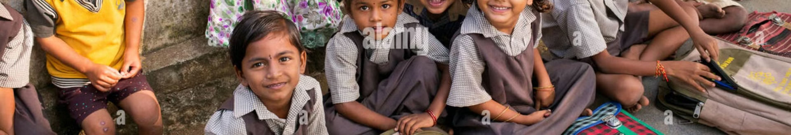




Education in Action: Lighting the Path to Knowledge
KNECT-Supported School
Increased Enrollment
Improved Literacy Rates
Digital Learning Resources
In a remote village in Rajasthan, KNECT supports a school that provides quality education to underprivileged children.
The school has witnessed a remarkable 60% increase in enrollment, demonstrating the community's eagerness for education.
Literacy rates have improved by 45%, empowering students with the skills they need to succeed.
Students now have access to digital learning resources, expanding their knowledge and opportunities.

Slide 6
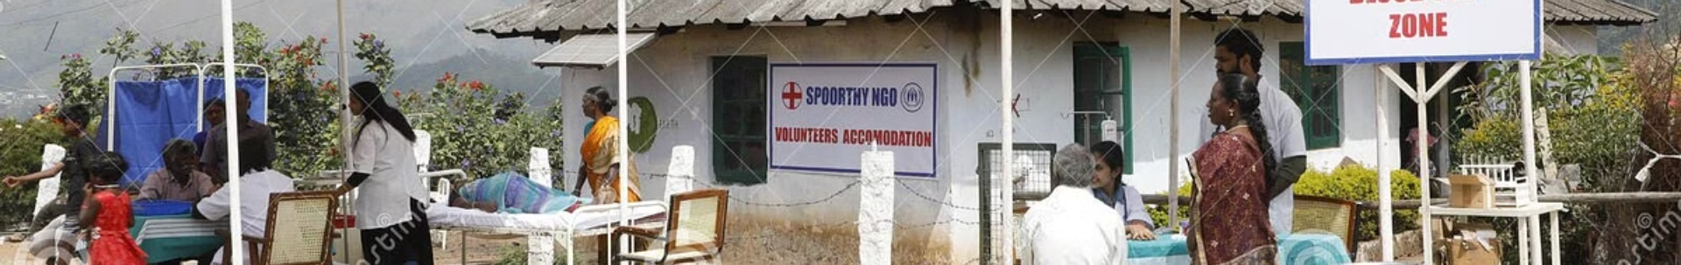
Healthcare in Action: Healing and Empowering Lives
Mobile Medical Camps
1
KNECT organizes mobile medical camps in underserved areas of Maharashtra to provide essential healthcare services.
2
Patients Treated
Over 5,000 patients with common ailments have been treated at these camps, bringing relief and healing to communities.
Health Screenings
3
Health screenings and preventive care are conducted to promote early detection and prevent the spread of diseases.
4
Reduced Mortality Rate
The mortality rate among children under five has been reduced by 20%, showcasing the impact of KNECT's healthcare initiatives.

Slide 7




Justice in Action: Upholding Rights and Fairness
Cases Resolved
Legal Aid Clinic
1
Over 200 cases of land disputes and discrimination have been resolved, empowering communities to protect their rights.
KNECT operates a legal aid clinic assisting marginalized communities in Bihar, ensuring access to justice.
2
Increased Awareness
Empowered Women
4
Increased awareness of legal rights and remedies among marginalized communities.
3
Women and other vulnerable groups are empowered to assert their rights and seek legal remedies.

Slide 8

KNECT's Impact: Tangible Results and Transformation
Individuals Impacted
Increased Access
Testimonials
Over 20,000 individuals directly impacted by KNECT's programs, demonstrating the wide reach and effectiveness of our initiatives.
A 50% increase in access to basic services in target communities, improving the quality of life for rural residents.
"KNECT has transformed my life by giving me access to education and healthcare," says a beneficiary. "I am now able to provide for my family and contribute to my community." Another beneficiary states, "KNECT helped me understand my legal rights and fight against discrimination."

Slide 9




Partner with KNECT: Investing in a Brighter Future
1
Vision
2
Impact
3
Support
4
Collaboration
Partner with KNECT to invest in a brighter future for rural India. Opportunities for collaboration and support include financial donations, volunteer programs, and in-kind contributions. We ensure transparency and accountability in resource allocation and strive for long-term sustainability through community ownership and empowerment. Together, we can make a lasting difference in the lives of those who need it most.

Slide 10
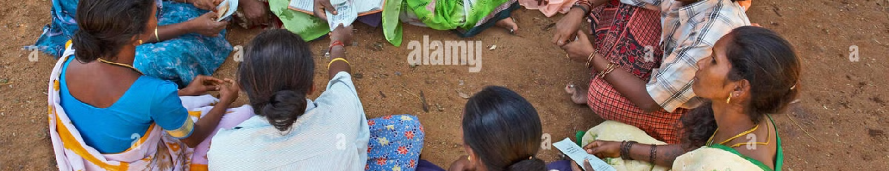
Join the KNECT Movement 🌍📚⚕️⚖️
Together, we can bridge the gaps and create a more just and equitable society for all. Visit our website to learn more about our programs and how you can get involved. Contact us to explore partnership opportunities. Donate today to support our mission and empower rural communities in India.
Website: [Insert Website Address]
Contact: [Insert Contact Information]
Donate: [Insert Donation Link]

